Slide 1
Theory of Automata
Finite Automata with Output
Dr Aftab Maroof
Nasreen Akhtar
Faryal Saud

Slide 2
Contents
Moore Machines
Mealy Machines
Moore = Mealy

Slide 3
Benefits
What is we want to do following to the word
  count the occurrence of a certain substring
  get the incremented number
  mark the locations of the substring in the word
  take the complement of the number
  Get the parity of the number
Final accepted/rejected may not be required
Not limited by the size of the buffer if we want to wait for the final output

Slide 4
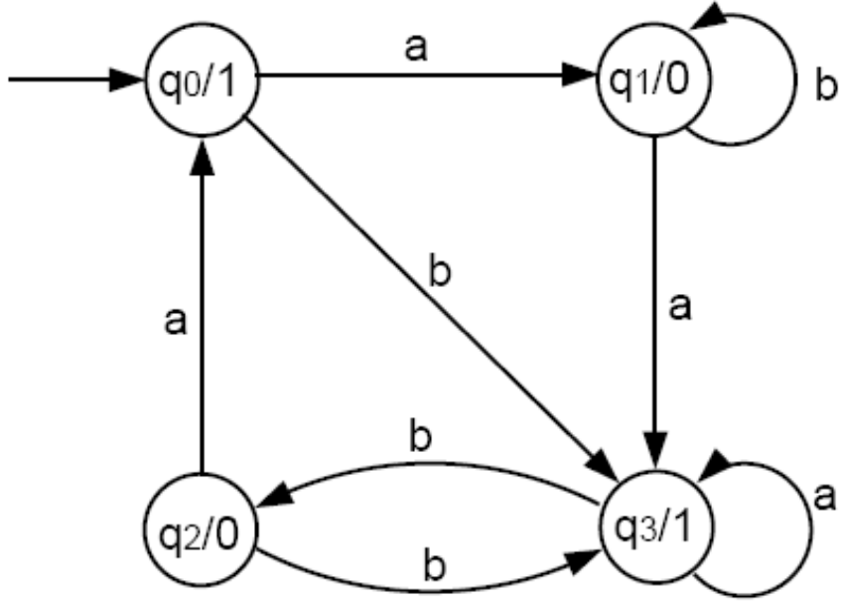
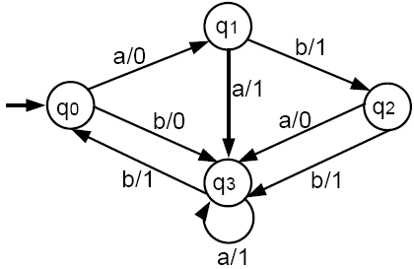
Moore vs Mealy Machines

Slide 5
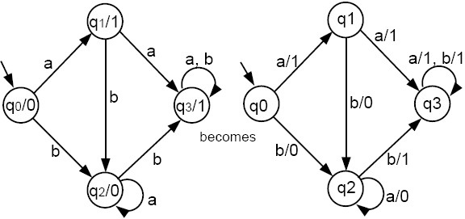
Moore vs Mealy Machines

Slide 6
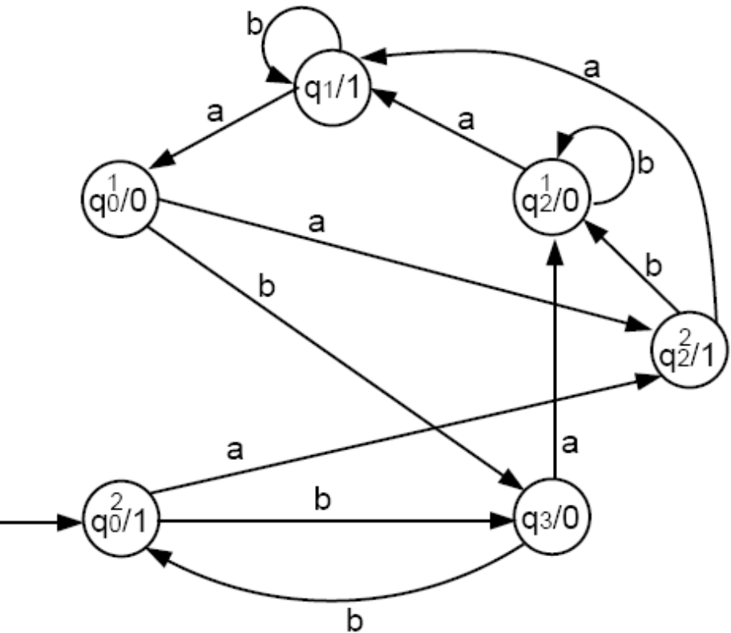
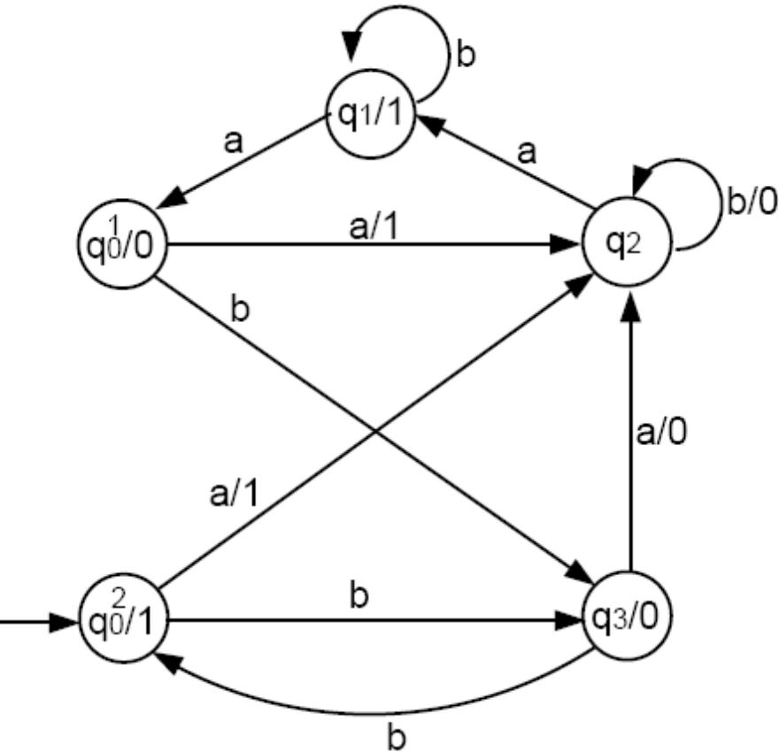
Moore vs Mealy Machines

Slide 7
Moore Machine Definition
Moore machine is a collection of five things:
A finite set of states q₀, q₁, q₂, ..., where q₀ is designated as the start state.
An alphabet of letters for forming the input string = {a, b, c, …}.
An alphabet of possible output characters Γ = {0, 1, 2, …}.
A transition table that shows for each state and each input letter what state is reached next.
An output table that shows what character from Γ is printed by each state as it is entered.

Slide 8
Notes
We did not assume that the input alphabet is the same as the output alphabet Γ.
To keep the output alphabet separate from the input alphabet, we give it a different name Γ (instead of ∑) and use number symbols {0, 1, …} (instead of {a, b, …}).
We refer to input symbols as letters, whereas we refer to output symbols as characters.
We adopt the policy that a Moore machine always begins by printing the character dictated by the mandatory start state. So, if the input string has 7 letters, then the output string will have 8 characters, because it includes 8 states in its path.

Slide 9
Notes Contd.
A Moore machine does not define a language of accepted words, because there is no such thing as a final state.
Every possible input string creates an output string. The processing is terminated when the last input letter is read and the last output character is printed.
There are some subtle ways to turn Moore machines into language definers.

Slide 10
Example: Moore machine defined by a table
Input alphabet: ∑ = {a, b}
Output alphabet: Γ = {0, 1}
Names of states: q₀, q₁, q₂, q₃ with q₀ being the start state.
Transition and output table (combined):
Old State | Output by Old State | New state after a | New state after b
q₀ | 1 | q₁ | q₃
q₁ | 0 | q₃ | q₁
q₂ | 0 | q₀ | q₃
q₃ | 1 | q₁ | q₂

Slide 11
Pictorial Representation
Moore machines have pictorial representations similar to FAs.
The difference is that inside each state, in addition to the state name, we also specify the output character printed by that state, using the format state – name/output.
Hence, the Moore machine in the above example has the following pictorial representation:

Slide 12
Example
We indicate the start state by an outside arrow since there is no room for the usual - sign.
Given the input string abab, the output sequence is 10010.
Note that the length of the output string is one longer than the length of the input string.

Slide 13
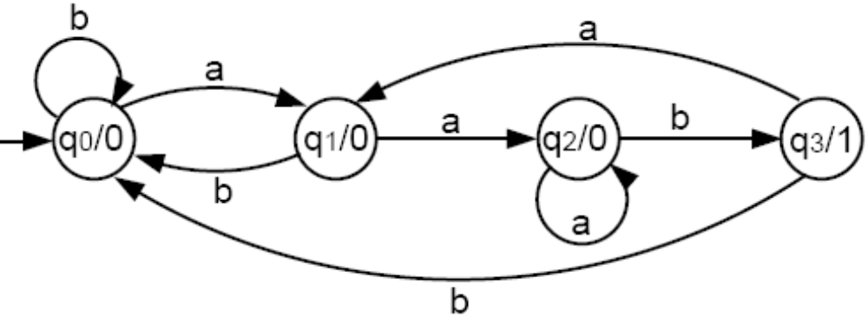
Example
Suppose we are interested in knowing exactly how many times the substring aab occurs in a long input string. The following Moore machine will count this for us:
Every state of this machine prints out a 0, except for q3, which prints a 1.

Slide 14
Example contd.
To get to q₃, we must have come from q₂ and have just read a b. To get to q₂, we must have read at least two a’s in a row.
After finding the subtring aab and tallying a 1 for it, the machine looks for the next aab. Hence, the number of 1’s in the output string is exactly the number of substrings aab in the input string.
Consider an FA that accepts a language L:
    – If we add printing character 0 to any non-final state and 1 to each final state, then the 1’s in any output string mark the end position of all substrings that are words in L.
    – In a similar way, a Moore machine can be said to define the
    language of all input strings whose output ends with a 1.
    – The Moore machine above with q0 = - and q3 = + accepts all
    words that end with aab.

Slide 15
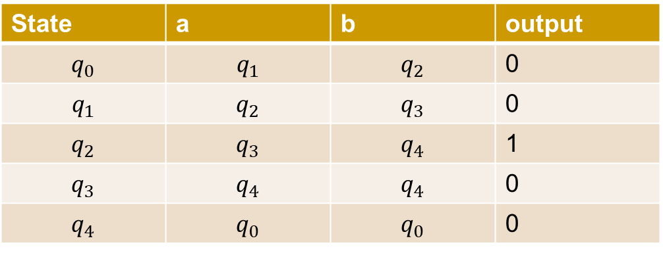
Example contd.
For the following Moore machine the input alphabet is =(a,b) and the output alphabet is {0,1}. Run the following input sequences and find the respective outputs
aaabab
abbabb
ababb
Aabab

Slide 16
Example contd.
Construct a Moore Machine that print ‘a’ Whenever the sequence ‘01’ is encountered in any input binary string

Slide 17
Melay machine Definition
A Mealy machine is a collection of four things:
1. A finite set of states q₀, q₁, q₂, ..., where q₀ is designated as the start state.
2. An alphabet of letters for forming the input string ∑ = {a, b, …}.
3. An alphabet of possible output characters Γ = {0, 1, …}.
4. A pictorial representation with states represented by small circles and directed edges indicating transition between states.
  Each edge is labeled with a compound symbol of the form i/o where i is an input letter and o is an output character.
  Every state must have exactly one outgoing edge for each possible input letter.
  The edge we travel is determined by the input letter i. While traveling on the edge, we must print the output character o.

Slide 18
Example
Given the input string aaabb, the output is 01110.
In a Mealy machine the output string has the same number of characters as the input string has letters.

Slide 19
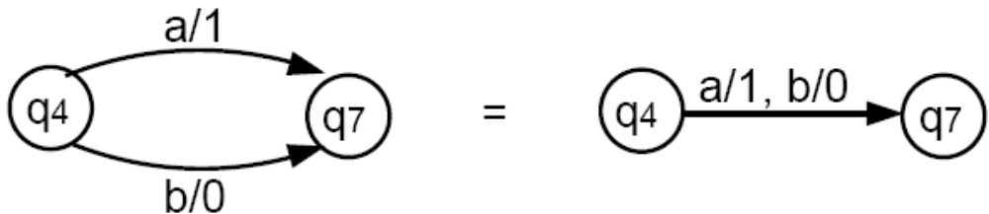
A Mealy machine does not define a language by accepting and rejecting input strings: It has no final states.
However, there is a sense in which a Mealy machine can recognize a language, as we will see later.
Note the following notation simplification:

Slide 20
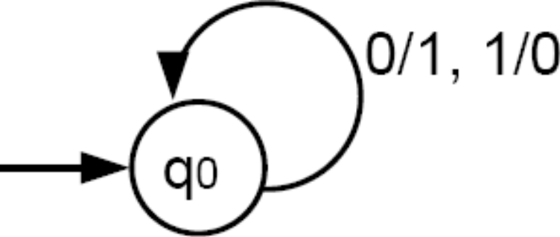
Example
The following Mealy machine prints out the 1’s complement of an input bit string.
This means that it will produce a bit string that has a 1 whenever the input string has a 0, and a 0 whenever the input has a 1.
If the input string is 001010, the output will be 110101

Slide 21
Example
Let consider a Mealy machine, called increment machine, which reads a binary number and prints out the binary number that is one larger.
Assume that the input bit string is a binary number fed in backward; that is, unit digit first, then 2’s digit, 4’s digit, etc.
The output string will be the binary number that is one greater and that is generated right to left.
The machine will have 3 states: start, owe-carry and no-carry. The owe-carry state represents the overflow when two bits of 1’s are added, we print a 0 and we carry a 1.

Slide 22
Example contd.
From the start state, if we read a 0, we print a 1 (incrementing process), and we go to the no-carry state. If we read a 1, we print a 0 (incrementing) and we go to the owe-carry state.
At any point in the process, in we are in the no-carry state, we print the next bit just as we read it and remains in no-carry.
However, if we are in the owe-carry state and read a 0, we print a 1 and go to no-carry. If we are in owe-carry and read a 1, we print a 0 and we loop back to owe-carry.

Slide 23
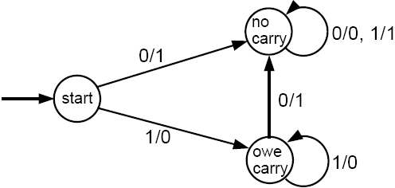
Example contd.
Let the input string be 1011 (binary representation of 11).
The string is fed into the machine as 1101 (backwards).
The output will be 0011, which when reversed is 1100 and is the binary representation of 12.
In Mealy machine, output length = input length. Hence, if input were 1111, then output would be 0000 (overflow situation).

Slide 24
Example
Although a Mealy machine does not accept or reject an input string, it can recognize a language by making its output string answer some question about the input.
Consider the language of all words that have a double letter (aa or bb) in them.
We can build a Mealy machine that can take an input string of a’s and b’s, and print out an output string of 0’s and 1’s such that if the n-th output character is a 1, it means that the n-th input letter is the second letter in a pair of double letters.
The complete picture of this machine is as follows:

Slide 25
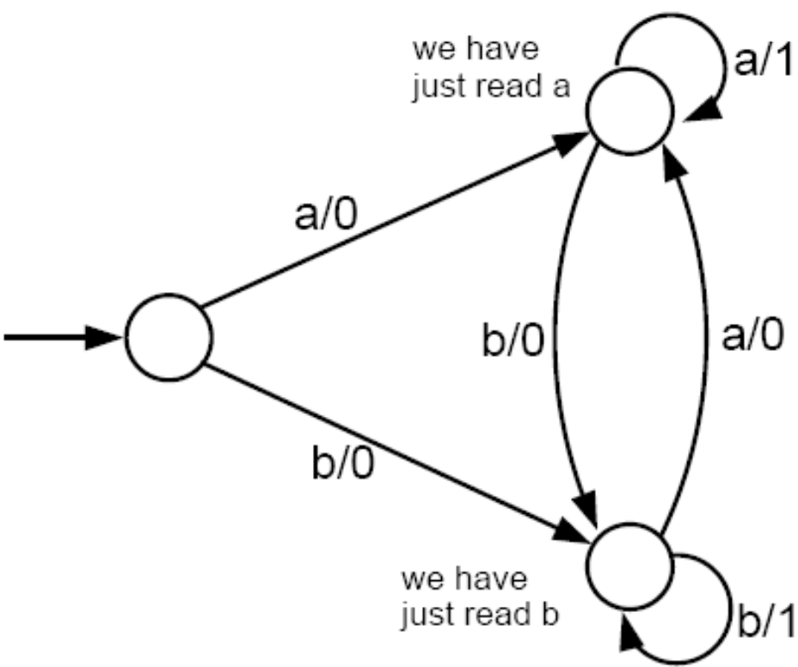
If the input string is ababbaab, the output will be 00001010.
This machine recognizes the occurrences of aa or bb.
Note that the triple letter word aaa produces the output 011 since the second and third letters are both the back end of a pair of double a’s.

Slide 26
Moore = Melay
So far, we have define that two machines are equivalent if they accept the same language.
In this sense, we cannot compare a Mealy machine and a Moore machine because they are not language definers.
Definition:
Given the Mealy machine Me and the Moore machine Mo (which prints the automatic start state character x), we say that these two machines are equivalent if for every input string, the output string from Mo is exactly x concatenated with the output string from Me.

Slide 27
Theorem 8
If Mo is a Moore machine, then there is a Mealy machine Me that is equivalent to Mo.
Proof by constructive algorithm:
Consider a particular state in Mo, say state q₄, which prints a certain character, say t.
Consider all the incoming edges to q₄. Suppose these edges are labeled with a, b, c, ...
Let us re-label these edges as a/t, b/t, c/t, ... and let us erase the t from inside the state q₄. This means that we shall be printing a t on the incoming edges before we enter q₄.

Slide 28
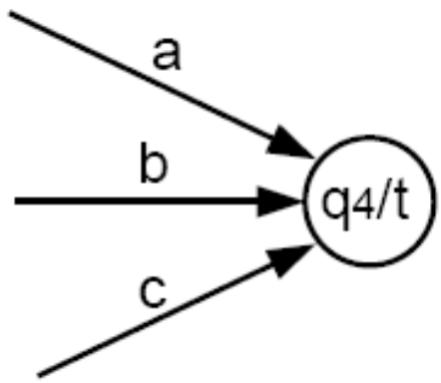
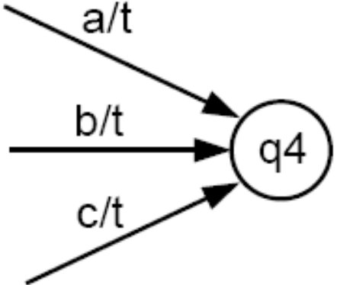
Proof by constructive algorithm contd.
becomes
We leave the outgoing edges from q₄ alone. They will be relabeled to print the character associated with the state to which they lead.
If we repeat this procedure for every state q₀, q₁, ..., we turn Mo into its equivalent Me.

Slide 29
Example
Following the above algorithm, we convert a Moore machine into a Mealy machine as follows:

Slide 30
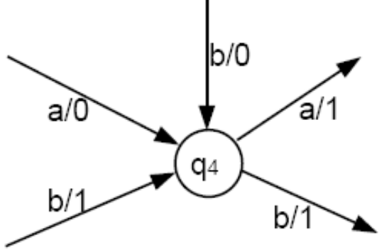
Theorem 9
For every Mealy machine Me, there is a Moore machine
Mo that is equivalent to it.
Proof by constructive algorithm:
We cannot just do the reverse of the previous algorithm. If we try to push the printing instruction from the edge (as it is in Me) to the inside of the state (as it should be for Mo), we may end up with a conflict: Two edges may come into the same state but have different printing instructions, as in this example:

Slide 31
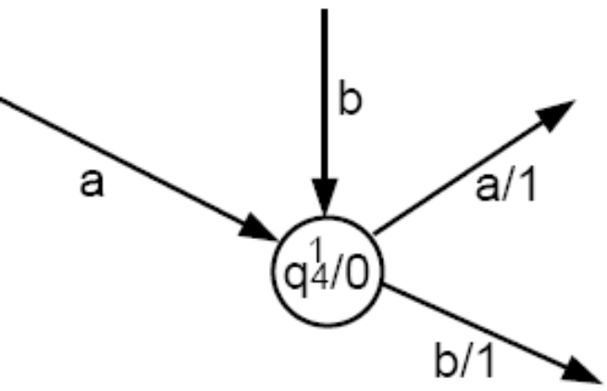
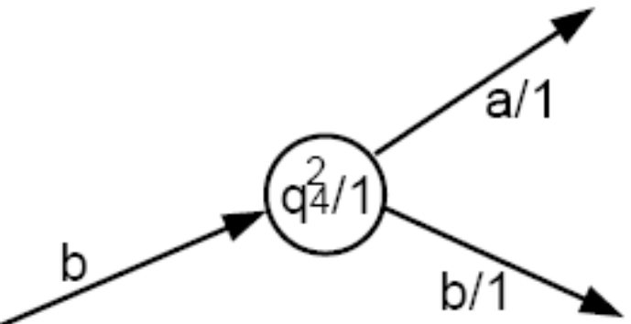
Proof by constructive algorithm (cont.):
What we need are two copies of q₄, one that prints a 0 (labeled as q¹₄/0), and the other that prints a 1 (labeled as q²₄/1). Hence,
  – The edges a/0 and b/0 will go into q¹₄/0.
  – The edge b/1 will go into q²₄/1.
The arrow coming out of each of these two copies must be the same as the edges coming out of q₄ originally.

Slide 32
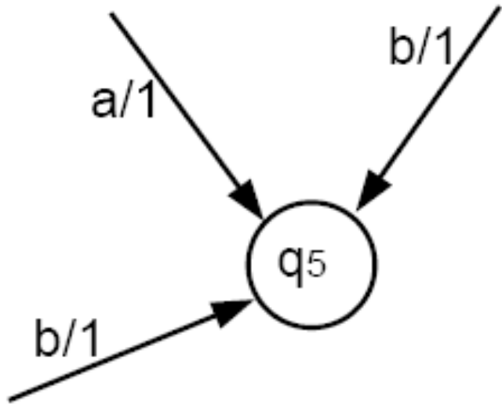
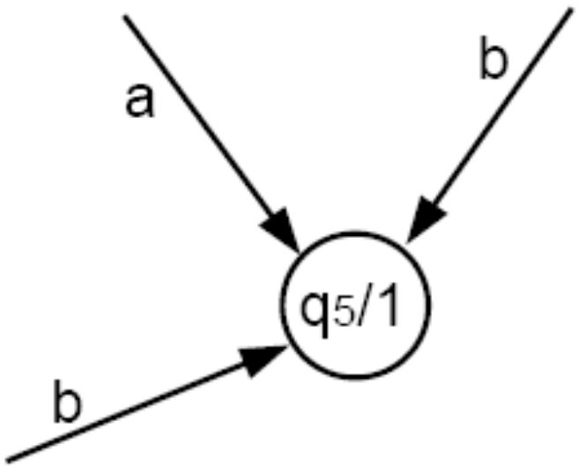
Proof by constructive algorithm (cont.):
If all the edges coming into a state have the same printing instruction, we simply push that printing instruction into the state.
becomes

Slide 33
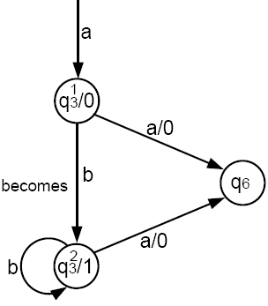
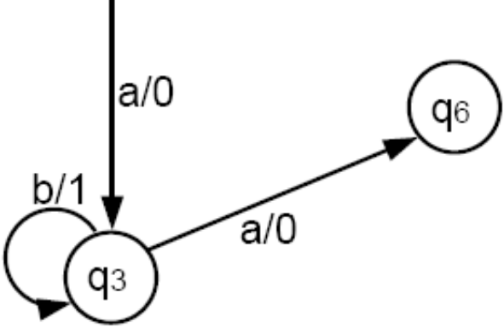
Proof by constructive algorithm (cont.):
An edge that was a loop in Me may becomes two edges in Mo, one that is a loop and one that is not.
becomes

Slide 34
Proof by constructive algorithm (cont.):
If there is ever a state that has no incoming edges, we can assign it any printing instruction we want, even if this state is the start state.
If we have to make copies of the start state in Me, we can let any of the copies be the start state in Mo, because they all give the identical directions for proceeding to other states.
Having a choice of start states means that the conversion of Me into Mo is NOT unique.
Repeating this process for each state of Me will produce an equivalent Mo. The proof is completed.
Together, Theorems 8 and 9 allow us to say Me = Mo.

Slide 35
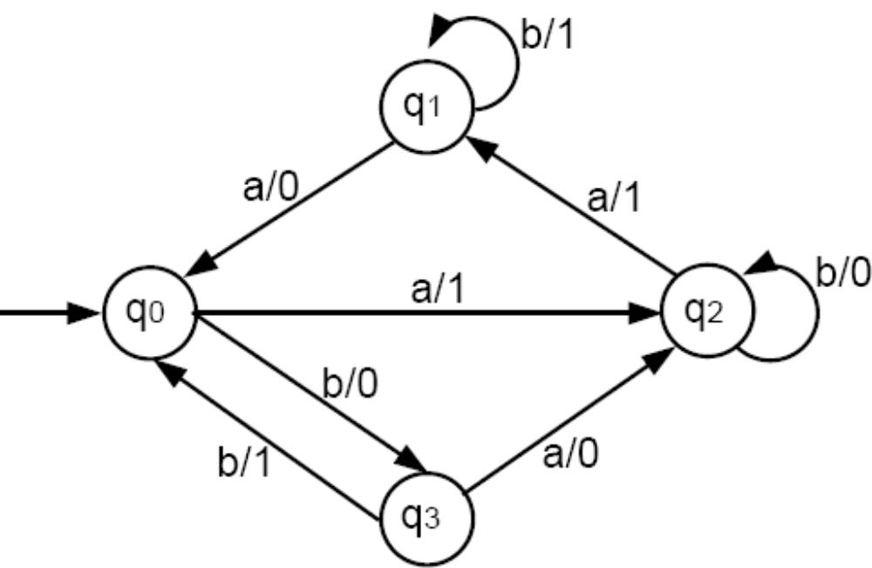
Example
Convert the following Mealy machine into a Moore machine:

Slide 36
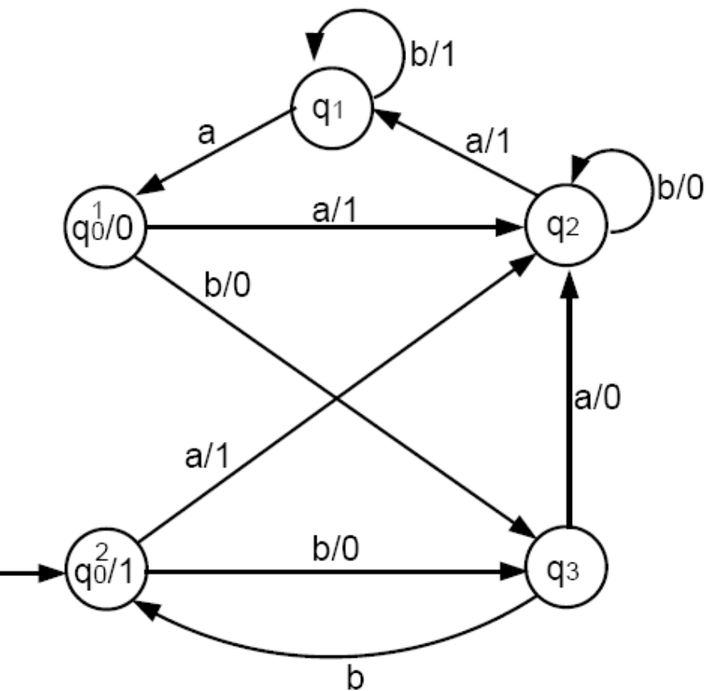
Example contd.
Following the algorithm, we first need two copies of q₀:

Slide 37
Example contd.
All the edges coming into state q₁ (and also q₃) have the same printing instruction. So, apply the algorithm to q₂ and q₃:

Slide 38
Example contd.
The only job left is to convert state q₂. There are 0-printing edges and 1-printing edges coming into q₂. So, we need two copies of q₂. The final Moore machine is:

